Slide 1
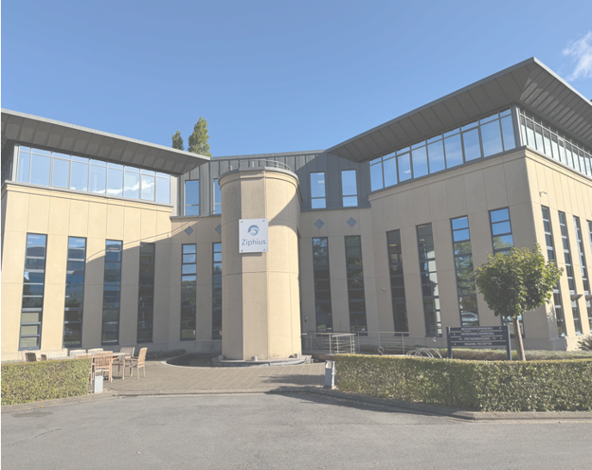
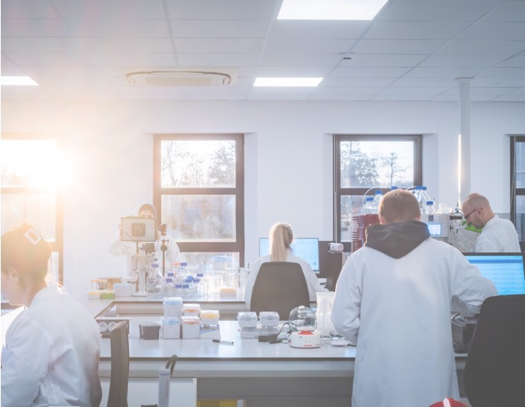
Challenges and opportunities for assessing stability of emerging modalities
- the case of self-amplifying RNA and LNPs
Date: 12 May 2026
Presenter: Iulia Oita

Slide 2
DISCLAIMER

Slide 3


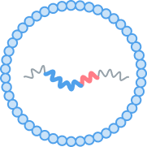
Ziphius is developing a proprietary technology to address significant unmet medical needs.
ZIPHIUS AT A GLANCE
Founded in 2019, located in Ghent, Belgium
Team of 40+ colleagues
Aiming to solve the shortcomings of conventional RNA by using our proprietary self-amplifying RNA platform
Successfully validated platform in NHP
Chlamydia trachomatis selected as lead indication

Slide 4
… about mRNA
Reputation of unstable material
Linked to several records in developability and regulatory advancement
Pursued for drug development in vaccines, gene therapy, cancer immunotherapy, protein replacement…
Manufactured by in vitro transcription
Large, very flexible single stranded, hydrophilic
Polyanion, negatively charged at physiological pH
Several forms have been developed:
  Conventional
  Self-amplifying
  Trans-amplifying
  Circular
Several structural features can be found in most forms:
How can we approach saRNA & LNP development and deliver a successful product?
McCafferty & all, Mol Ther 2022, 2968-2983; Papukashvili & all, Int J Mol Sci 2022, 12884

Slide 5
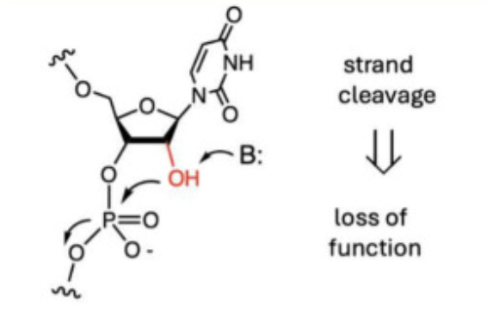
mRNA structural features and derived stability challenges
Very long, single strands -> integrity of mRNA primary structure required for expression of intended protein & correct structure of protein
  saRNA ±9000 nts length or longer
  Degradation rate generally increases with length
Presence of 2’OH on the sugar unit
  Increases susceptibility to strand breakage (via transesterification)
Higher order structure (secondary)
  Able to form a very large number of secondary and tertiary structures
  Transition between these structures can occur very fast
  May stabilize mRNA molecules
  Transesterification has a higher rate in unstructured mRNAs
  mRNA conformation in LNPs -> impact on mRNA stability
Banerjee & all, ACS Cent Sci 2025, 2400-2409

Slide 6

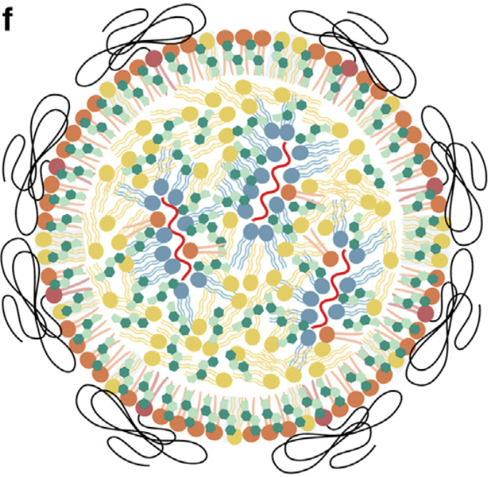
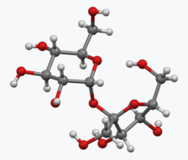
(sa)RNA-LNP drug product
 |  |  | Traditional vaccines | (sa)RNA-LNPs
manufacturing |  |  | cell culture and complex media | relatively simple, no cell culture; no complex media
composition | active component | active component | less well known | well defined (RNA)
 | critical excipients | critical excipients | immune response adjuvants (eg aluminum hydroxide, squalene oil) | lipids
 | other excipients | other excipients | antimicrobial preservants, stabilizers | cryoprotectants
(sa)RNA-LNP drug product (DP)
Small molecules
(buffer, cryoprotectant)
(sa)RNA-LNP
RNA-LNP are complex materials of well-defined composition
(sa)RNA (DS)
lipids
LNP schematic according to Trollmann &Bockmann, Biophys . J., 121, 3927-3939, 2022

Slide 7
Stability profile of saRNA and LNPs
Typical long term storage conditions:
  DS (saRNA): <-60°C
  DP (LNP, liquid ): -20°C±10°C
Size matters
  As molecule length increases, RNA is more susceptible to degradation
  Degradation rate is concentration dependent
Good candidate for stability “platform knowledge”
  Common “backbone” -> common degradation pathways
  Highly similar analytical test procedures
Colloidal stability of LNPs seems less of an issue (based on internal data for Ziphius formulations)
  Requires cryoprotectant and extra protection during shipment
  Strong physical stress is required to destabilize the LNPs → aggregation can be observed (depending on type and intensity of the physical stressor)
Main degradation pathways for RNA and LNPs

Slide 8
Building a stability program for saRNA and LNPs
“Beginning” problems:
  Implementing a solid fit-for-purpose analytical toolbox
  Defining the stressed stability setup
    Temperature? Timepoints?
    saRNA vs LNPs?
  How much can we extrapolate?
    constructs with same backbone but different GOIs?
    constructs with different backbones?
  Understanding limitations of in vitro expression methods → applying a holistic approach to understand ”potency”
Early development challenges:
  Provide solutions (=stability data or predictions) to support formulation development, process & product development, in vivo studies
  Ability to deal with a panel of constructs → define “worst case” or bracketing approach
  Building towards platform stability knowledge
Release only vs stability indicating quality attributes (first and second line) for DP (LNPs)
Next step = implementing a predictive model?
LNP schematic according to Trollmann &Bockmann, Biophys . J., 121, 3927-3939, 2022

Slide 9
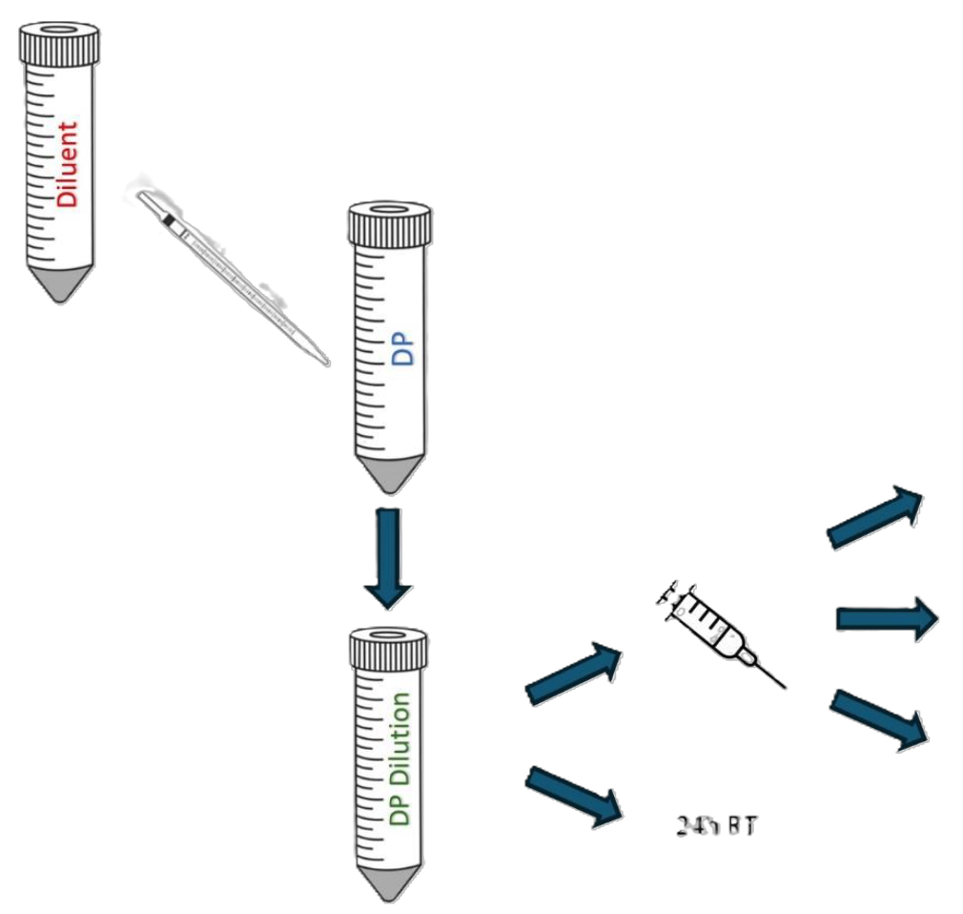
Case study 1: supporting in vivo studies during early development
Is the material handled correctly by the CRO?
Aim: define a flow for thawing, diluting and handling LNPs that can be easily implemented by a CRO for an animal study, while ensuring DP quality is maintained
Additional considerations:
  Study flow at CRO:
    where is the material diluted? in a lab? at animal facility?
    how is the diluted material transported?
    how long and which temperature exposure can be anticipated?
  Compatibility with materials (labware, syringes, needles)
Tested quality attributes:
  RNA concentration,
  RNA integrity & purity,
  (in vitro expression)
Challenges:
  Concentration of diluted LNPs may be too low for some analytical test methods → how to concentrate with minimal impacting on the material?
  Handling analytical variability to get to clear conclusions
Study set-up
Concentrated (sa)RNA-LNP DP
4h fridge
4h ice
Diluted
(sa)RNA-LNP DP
“ready to use”
Expel
asap
24h RT
Main benefits: increased product knowledge & confidence in animal study results

Slide 10
Case study 2: supporting in vivo studies during early development
Can storage stability of saRNA be improved?
Aim: evaluate how stability of saRNA can be improved further by changing its final matrix
Setup:
  Screening for most suitable matrix
  Manufacture construct X in the most promising matrix and current one
  Follow in stability:
    Stressed stability (1 week @ 25°C ±2°C)
    Accelerated stability (3-6 months @ 5°C±3°C)
    Long term storage (relevant constructs only)
Tested quality attributes:
  First line stability indicating & Limited set from second line
  Additional characterization for strategically selected samples
Challenges:
  Impact of sample matrix on test methods→ how to discriminate between interference and degradation?
  Handling potential conflicts between stability and manufacturability → right choice when “best” stability matrix proves to cause unexpected problems in manufacturing?
saRNA integrity for a construct produced in two different matrixes
Most suitable matrix from a stability perspective may bring new challenges

Slide 11
Case study 3: choosing the right analytical tools
What are the most relevant attributes to describe LNP stability?
Aim: evaluate stability profile of a bivalent LNP formulation used in an important animal study
Main challenge = “beginning pains”:
  Early days of the CMC group → limited analytical tools, i.e. purity &IVE methods still in development
  Advanced R&D program with very ambitious timelines
  Too much literature focused on insufficiently descriptive quality attributes (Ribogreen, size, PDI, LNP sample prep to release the RNA….)
Setup:
  “Full blown” stability study
  Samples reserved for all test method, including the ones in development
Results :
  Ribogreen, PDI & size → no stability issues?
  At first instance, RT-q-PCR results contradicted the Ribogreen, PDI & size conclusions
  Confirmed later, when extra analytical tools became available
Ribogreen (total RNA)
RT-qPCR (construct1)
LNP-polydispersity
LNP-size
Focusing on the incorrect attributes can be misleading

Slide 12
Summary & conclusions
Challenges for the stability assessment of emerging modalities such as saRNA and LNPs
  “Beginning” problems:
    Availability & maturity of the analytical toolbox
    Designing the stability program based on the saRNA stability profile
    Prior knowledge is still work in progress
  Typical early development challenges, i.e. ability to deal with sets of constructs rather than one candidate and adapt fast to changes driven by in vivo data
Opportunities & added value for integrating the stability strategy early in development
  Building towards platform stability knowledge
  Using stressed stability model to predict stability impact for formulation and process changes
  Considering implementation of predictive models

Slide 13
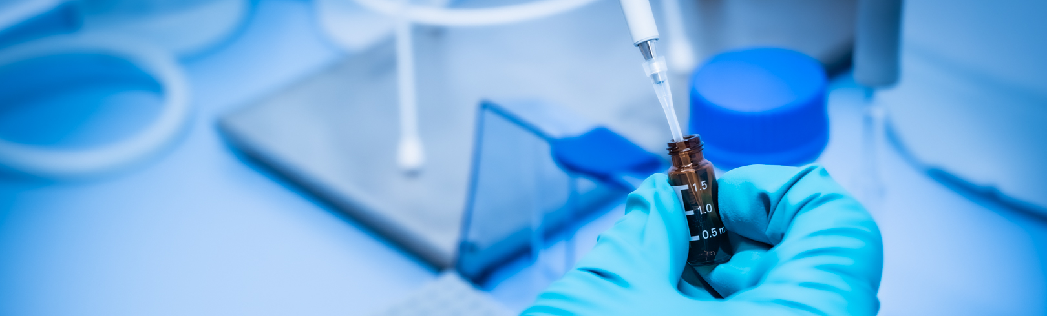



Company
Address
Rijvisschestraat 120
9052 Zwijnaarde
Belgium
Company
LinkedIn
Company
Website

