Slide 1
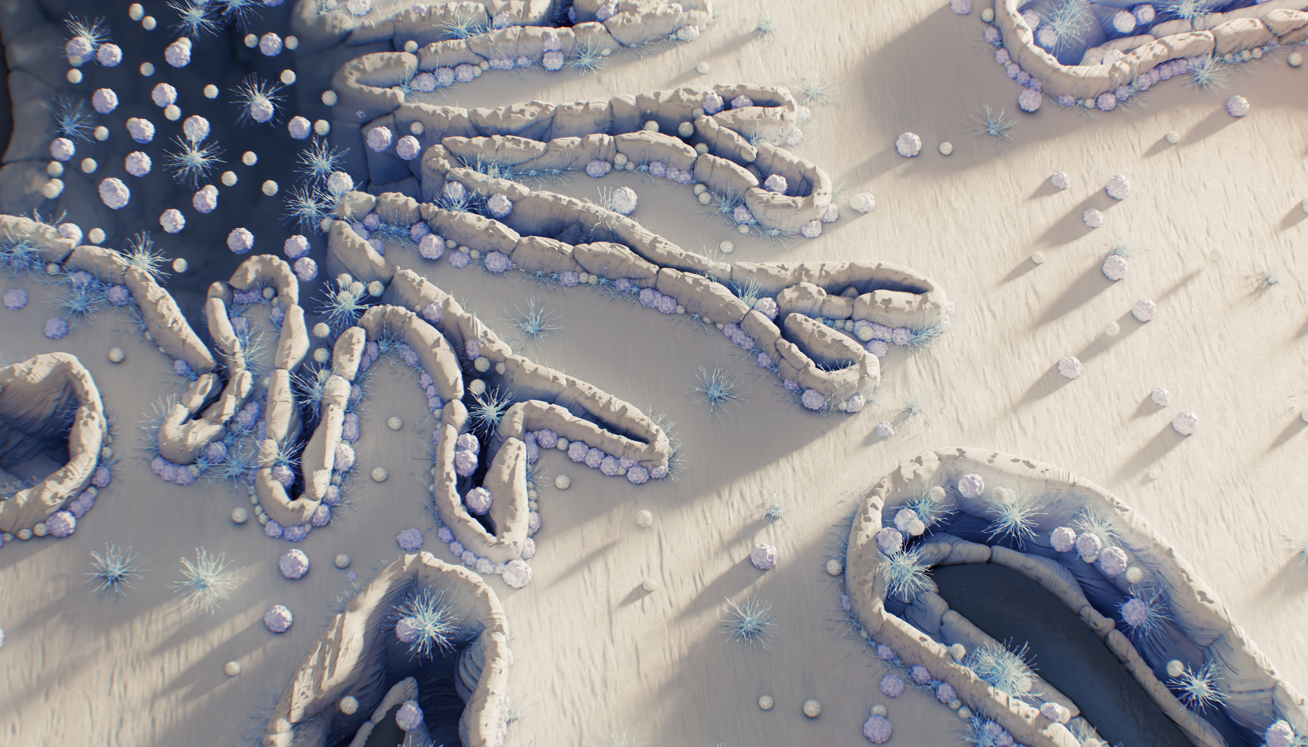
Accelerated Stability Prediction for Biotherapeutic
CASSS VEDG
Drago Kuzman
12-May 2026
RA CMC, TRD

Slide 2
Disclaimer
These slides are intended for educational purposes only and for the personal use of the audience.
These slides are not intended for wider distribution outside the intended purpose without presenter approval.
The content of this slide deck is accurate to the best of the presenter’s knowledge at the time of production.

Slide 3
Agenda
1 | Introduction to stability modeling
2 | Standard approach: extrapolation in time
3 | Alternative approach: extrapolation in temperature by Arrhenius (AKM)
4 | Model assumptions
5 | PoC for biological drugs

Slide 4
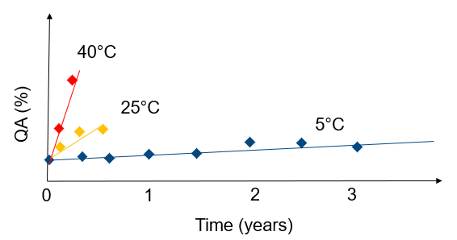
Stability Studies of Biologics
Drug Candidate selection
Formulation screening
Shelf life-assessment of clinical material
Final formulation screening
Primary packaging screening
Formulation robustness
Out-of-fridge studies
Cumulative hold times studies
Shel-life claim of commercial drug
Post approval process changes
…

Slide 5
Shelf-Life Determination of Commercial Biologics
end of shelf-life specifications
QA (%)
Shelf-life
0
1
2
3
Time (years)
ICH Q5C “ Primary data to support a requested storage period for either drug substance or drug product should be based on long-term, real-time, real-condition stability studies.”
Q5C Guideline.pdf

Slide 6
ICH Q1 Stability Revision is in its Public Consultation Phase
May 2026
November 2026
June 2026
Step 5
Step 4
Step 3
- Implementation by Regulators
Step 2
- Adoption of final guideline (or revision)
Step 1
- Public Consultation
Adopted by
Regulators
- Draft guideline adopted
- Consensus Building
- Develop draft guidance
Sign-off by
Regulatory
Topic leads
Endorsement
by ICH assembly
and Regulators
Concept Paper
Business Plan
Concept paper outline
developed by QDG
Dec 2020
Sign-off by
Industry & Regulators
Q2 2025 Q2 2027
Revision of ICH Stability training materials
Annex II about enhanced stability modeling to claim a commercial shelf life beyond real data
From EFPIA

Slide 7
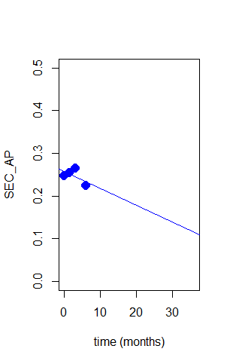
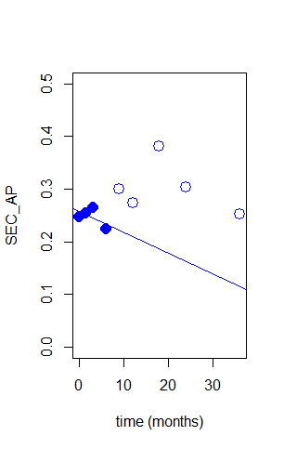
Standard approach:
Stability Extrapolation in Time Beyond Real Data
SEC Aggregates (%)
6 months data
3 years data
Long-term stability extrapolation of 6 months stability might not be reliable. Why?
At intendant storage condition 5°C, the degradation of biologics is notably slow, often requiring a year or more for a reliable determination.
The level of degraded biologics at 5°C stays within the variability range of analytical methods for several months.​
(%)
(%)

Slide 8

Alternative approach (component 1):
Extrapolation in Temperature by Arrhenius based modeling
40 °C
40 °C
25 °C
QA
QA
t
Time
t
5*t
Time
$$k\left(T\right)=A∙\exp^{−\frac{E_{a}}{R∙T}}$$
40 °C
25 °C
Extrapolation in Temperature | Time Factor for Ea=20 kcal/mol
40°C -> 25 °C | 5
40 ˘C -> 5 °C | 57
25°C -> 5 °C | 11
5 °C
QA
t
5*t
Time
57*t

Slide 9


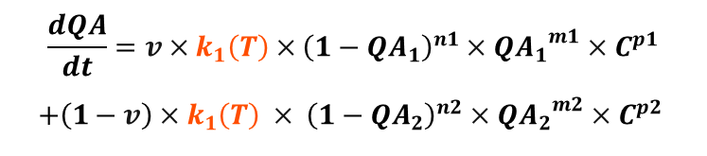
Alternative approach (component 2):
Kinetic model of degradation profile
…
QA
QA
QA
Time
Time
Time
$$\frac{dQA}{dt}=v×k_{1}\left(T\right)×{\left({1−QA}_{1}\right)}^{n1}×{{QA}_{1}}^{m1}×C^{p1}$$
$$+\left(1−v\right)×k_{1}\left(T\right) × {\left({1−QA}_{2}\right)}^{n2}×{{QA}_{2}}^{m2}×C^{p2}$$
$$\frac{dQA}{dt}=−k(T)$$
$$\frac{dQA}{dt}=−k\left(T\right)×QA$$
Zero order (linear) model
First order (exponential) model
N-order two step model
(Šesták–Berggren equation)

Slide 10
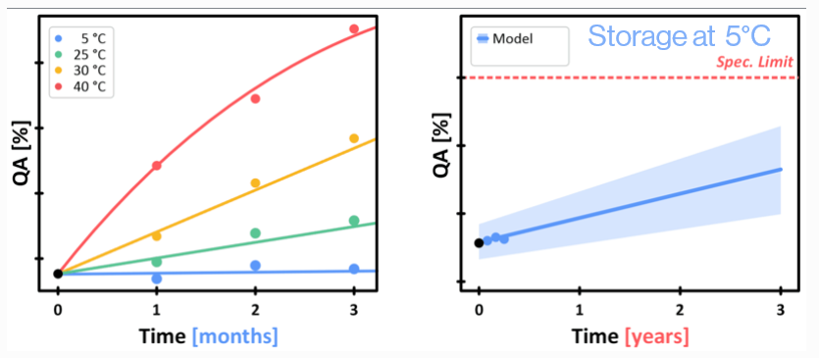
Accelerated Predictive Stability for Biologics
Modellable stability indicating CQAs
Non-Modellable stability indicating CQAs
Risk Assessment based on prior data and knowledge
Reliable degradation model for most of QAs: Arrhenius based First-order (exponential) kinetic model
Key assumption: The model is trained using data generated under accelerated conditions, where the dominant degradation mechanism is the same as under the intended storage condition.

Slide 11
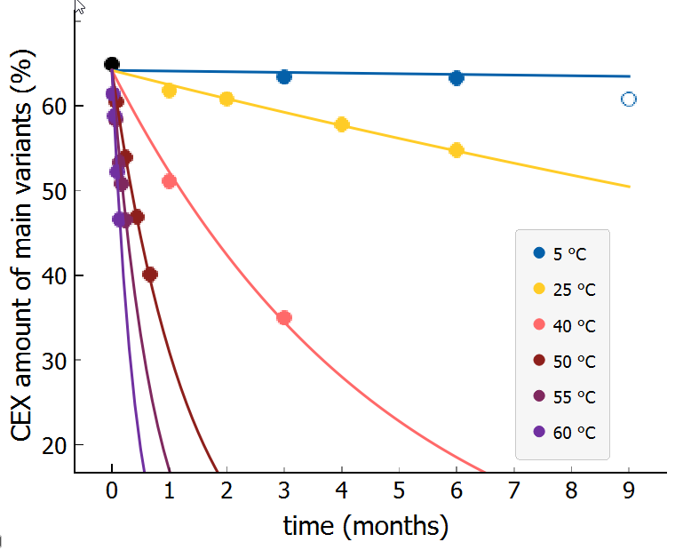
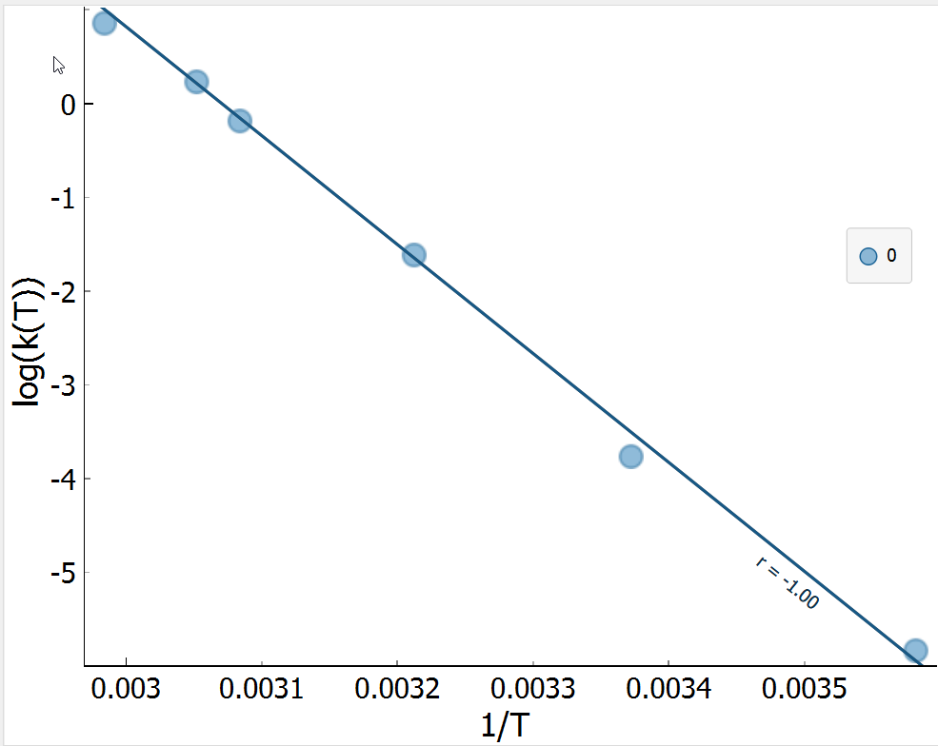
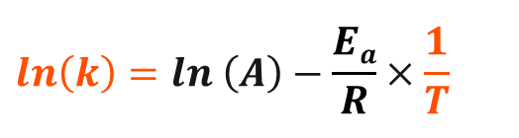
Validation of Arrhenius Assumption Across All Conditions Used For Model Training
Arrhenius plot
graphical representation of Arrhenius equation
$$ln\left(k\right)=ln \left(A\right)−\frac{Ea}{R}×\frac{1}{T}$$
2021 Kuzman et al. Scientific Reports https://doi.org/10.1038/s41598-021-99875-9

Slide 12
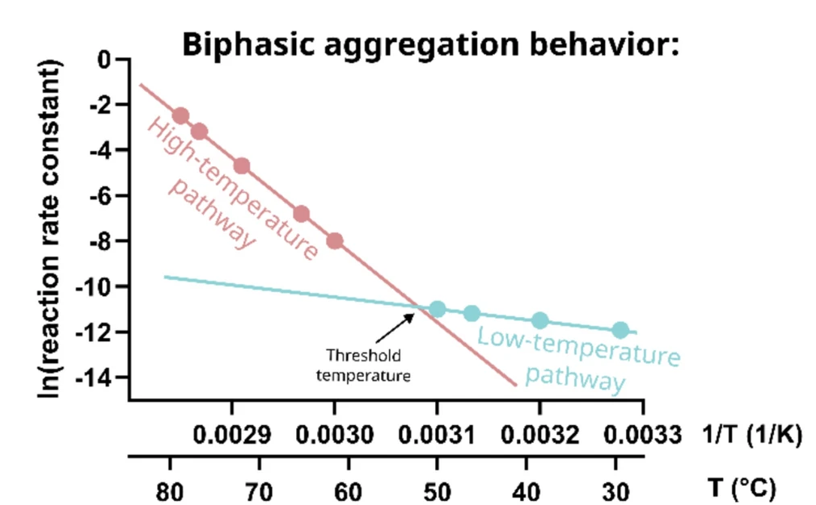
Different aggregation mechanism at higher temperature
Ea₁
Ea₂
Zidar et at., Scientific Reports 2025, https://doi.org/10.1038/s41598-025-07037-y

Slide 13
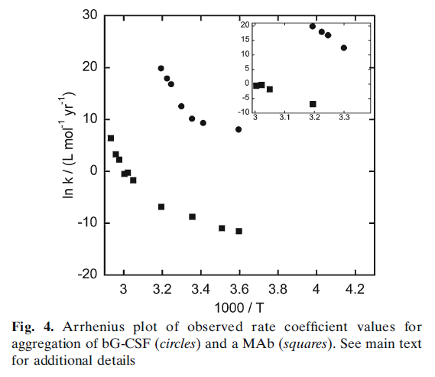
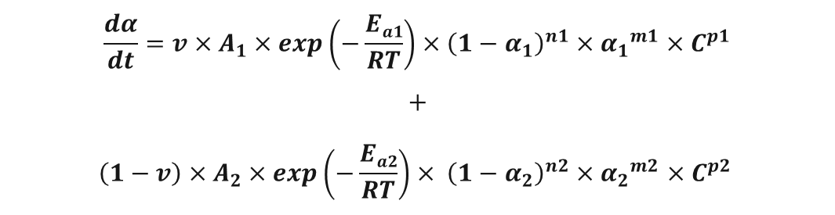
Aggregation modeling (option 1): Two Steps Kinetics model
T: 5°C - 65°C
Aggregation profiles can be modeled by using two steps Advanced Kinetic modeling:
$$\frac{dα}{dt}=v×A_{1}×\exp\left(−\frac{Ea1}{RT}\right)×{\left({1−α}_{1}\right)}^{n1}×{α_{1}}^{m1}×C^{p1}$$
$$+$$
$$\left(1−v\right)×A_{2}×\exp\left(−\frac{Ea2}{RT}\right)× {\left({1−α}_{2}\right)}^{n2}×{α_{2}}^{m2}×C^{p2}$$
Wang & Roberts:, Non-Arrhenius Protein Aggregation, AAPS Journal, Vol. 15, No. 3, July 2013

Slide 14
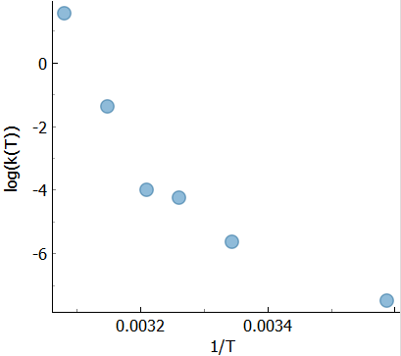
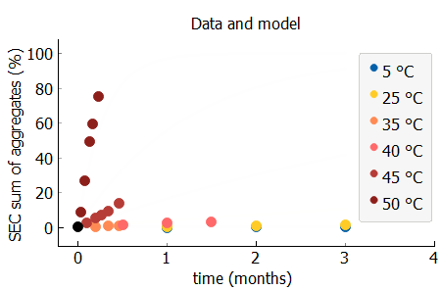
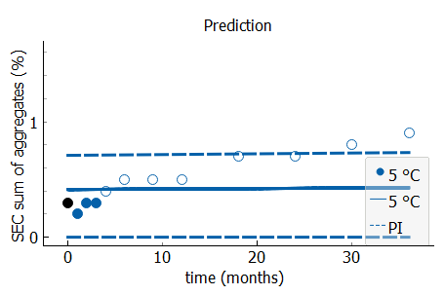
Aggregation modeling (option 2): First Order Kinetics Model
Accelerated stability data
Arrhenius plot
T [5 - 50 °C]
Ea = 59.6 kcal/mol
undersestimated

Slide 15
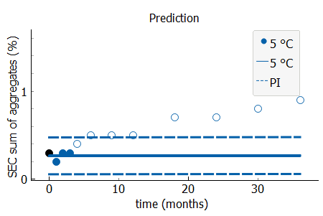
Aggregation modeling (option 2): First Order Kinetics Model
Accelerated stability data
Arrhenius plot
T [5 - 50 °C]
Ea = 59.6 kcal/mol
T [5 - 45 °C]
Ea = 54.0 kcal/mol
undersestimated
undersestimated

Slide 16
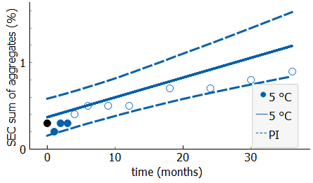
Aggregation modeling (option 2): First Order Kinetics Model
Accelerated stability data
Arrhenius plot
T [5 - 50 °C]
Ea = 59.6 kcal/mol
T [5 - 45 °C]
Ea = 54.0 kcal/mol
T [5 - 40 °C]
Ea = 21.4 kcal/mol
undersestimated
undersestimated

Slide 17
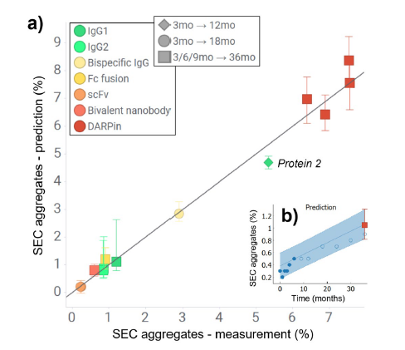
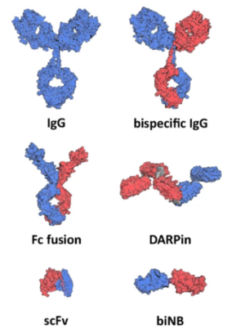
Aggregation Can Be Reliably Modeled
Long-term prediction at 5°C based on short term accelerated stability study
For robust Aggregation modeling it is key to know temperature threshold value allowing you to train the model by using a data from low temperature pathway.
Temperature threshold for mAb like formats is typically >40° C, for bi-valent nano body >35° C and for ScFv and DARpin >30° C.
Zidar et at., Scientific Reports 2025, https://doi.org/10.1038/s41598-025-07037-y

Slide 18
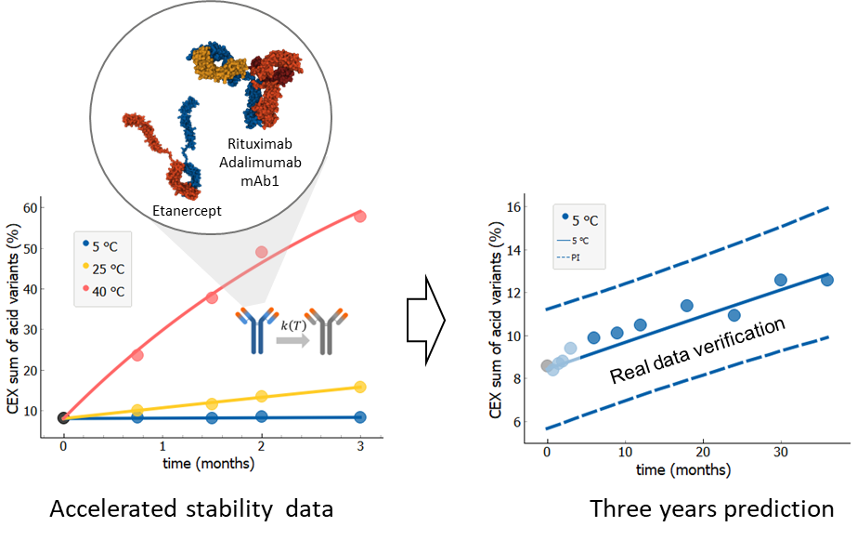

By proper temperature range selection one can reduce model complexity
First Order Kinetic model
$$\frac{dα}{dt}=v×A_{1}×\exp\left(−\frac{Ea1}{RT}\right)×{\left({1−α}_{1}\right)}^{n1}×{α_{1}}^{m1}×C^{p1}+\left(1−v\right)×A_{2}×\exp\left(−\frac{Ea2}{RT}\right)× {\left({1−α}_{2}\right)}^{n2}×{α_{2}}^{m2}×C^{p2}$$
$\frac{dα}{dt}=A×\exp\left(−\frac{Ea}{RT}\right)×$ $\left(1−α\right)$
Less model parameters (y₀, y_{inf}, A, E_{a})
Increased model robustness
Reduced risk of overfitting
Less data required
Kuzman D., et al., Sci Rep. 2021 Oct 15;11(1):20534. doi: 10.1038/s41598-021-99875-9.

Slide 19
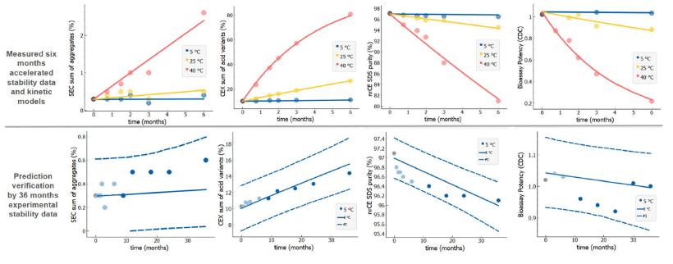
PoC: Novartis examples with long term validation
Aggregates
Acidic variants
nrCE-SDS purity
Bioassay
 | mAb1 | Rituximab | Etanercept | Adalimumab
CEX amount of main variants (%) | 100% | 91% | 100% | 99%
CEX sum of acid variants (%) | 100% | 97% | 100% | 99%
nrCE SDS purity (%) | 100% | 95% | 100% | 98%
nrCE SDS sum of fragments (%) | 100% | no data | no data | no data
Relative potency | n.a. | 97% | 100% | 100%
SEC purity (%) | 100% | 98% | 90% | 100%
SEC sum of aggregates (%) | 100% | 94% | 90% | 97%
Percentage of validation data within 95% prediction interval
2021 Kuzman et al. Scientific Reports https://doi.org/10.1038/s41598-021-99875-9

Slide 20
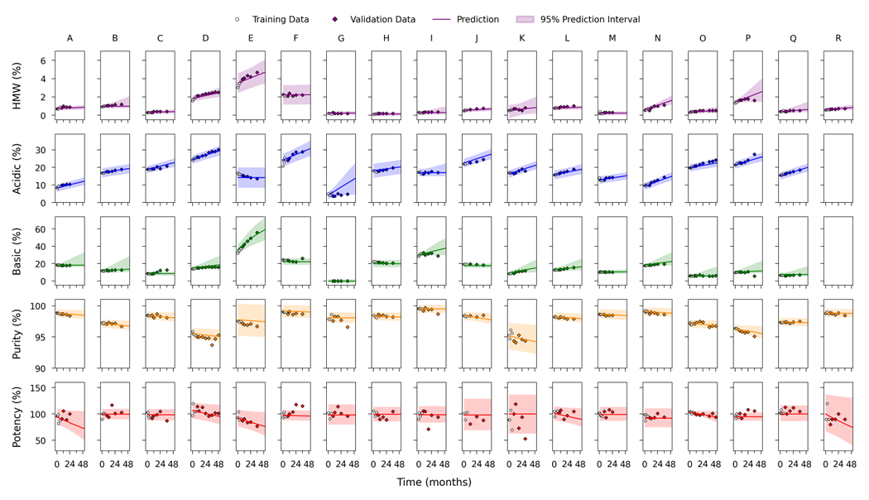
PoC: examples from >18 biologics product
Broad application of Arrhenius first order kinetic modeling across different biotherapeutic modalities.
Drug Product | State | Modality | Subtype | Concentration (mg/mL)
A | Liquid | mAb | IgG4 | Medium
B | Liquid | mAb | IgG1 | Medium
C | Liquid | mAb coform | IgG1 + IgG4 | Low
D | Liquid | mAb | IgG1 | High
E | Liquid | mAb | IgG4 | High
F | Liquid | ADC | IgG1 | Low
G | Lyophilized | ADC | IgG1 | Low
H | Liquid | mAb | IgG4 | Low
I | Lyophilized | mAb | IgG4 | Low
J | Liquid | mAb | IgG4 | High
K | Liquid | mAb | IgG1 | High
L | Liquid | mAb | IgG4 | Low
M | Liquid | mAb coform | IgG4 + IgG4 | Low
N | Liquid | mAb | IgG4 | Medium
O | Liquid | mAb | IgG1 | Medium
P | Liquid | mAb | IgG1 | Medium
Q | Liquid | mAb coform | IgG1 + IgG4 | Low
R | Lyophilized | Fusion Protein | N/A | Medium
2024 Dillon et al., Predicting the Long-Term Stability of Biologics with Short-Term Data, https://doi.org/10.1021/acs.molpharmaceut.4c00609
More examples: (Huelsmeyer, Kuzman et al. 2023),(Lennard, Zimmermann et al. 2024),(Dillon, Xu et al. 2024),(Kuzman, Bunc et al. 2021),(Bunc, Hadzi et al. 2022),(Doshi, Martin and Tomlinson 2020)

Slide 21
Conclusions
Advance Kinetic Modeling of Stability for Biologics
Arrhenius equation enables extrapolation in temperature which leads to faster, precise long-term predictions from accelerated data
Different kinetic models can be applied, however “simpler is better”
For biological drug, most of the modellable quality attributes can be described by first order Arrhenius kinetics
Model Assumptions Validation
Goodness of fit
Extrapolation in temperature by Arrhenius plot and/or fir of independent data set from recommended storage condition to the predicted profile
Ongoing Verification
Fit of recommended storage condition data obtained after model finalized (e.g. post-approval)
Applications
Stability modeling supports candidate/formulation selection, temperature excursions, hold times, control strategy, shelf-life claims,…

Slide 22
Thank you

