Slide 1
Assessing stability of well-characterized
Biotechnology Products
Virtual European discussion group
Tuesday, 12 May 2026 at 16:00 CEST

Slide 2
Disclaimer
These slides are intended for educational purposes only and for the personal use of the audience.
These slides are not intended for wider distribution outside the intended purpose without presenter approval.
The content of this slide deck is accurate to the best of the presenter’s knowledge at the time of production.

Slide 3
FOCUS : well-characterized Biologics
(e.g. CHO cell expressed mAb-like proteins)
Most Recombinant Protein Products are Now 'Well Characterized'
Extensive characterization testing and broad prior knowledge
Extensive formulation development knowledge from like-molecules
Robust manufacturing process knowledge from platform technologies
Understood product related and process related impurities
Understood quality attributes and characteristics
Understood criticality/impact of quality attributes on biological activity (potency)
Risk of immunogenicity considered for each attribute
Understanding product degradation pathways and stability-indicating attributes
Defined quality profile with analytical control strategy to monitor product quality

Slide 4
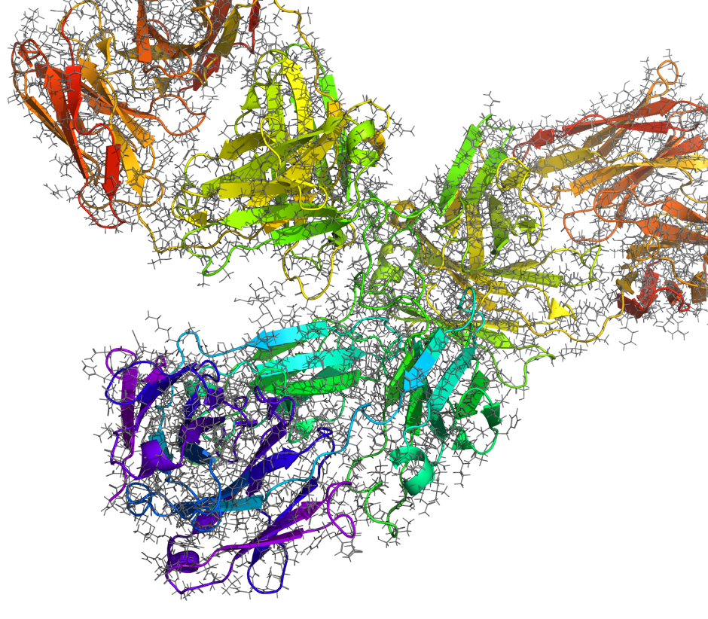
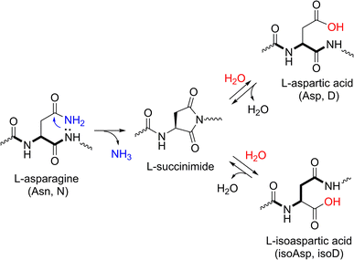
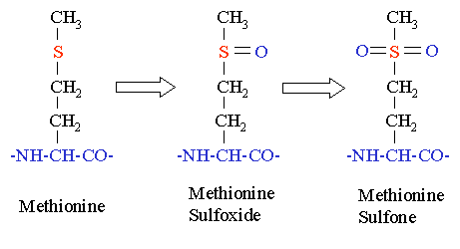
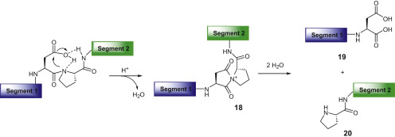
Degradation pathways of a protein
Deamidation of Asparagine side chain
to Aspartate or iso-Aspartate
Oxidation of Methionine side chain
IgG1 Antibody: >1300 amino acids (145 kDa)
Glycosylation: > 5 kDa
Charged groups: Lys, Arg, His, N-term,
Asp, Glu, C-term
Fragmentation of peptide backbone at Asp-Pro in flexible loop and acidic pH
Picture: www.schrodinger.com
From: Yi Yang, Side Reactions in Peptide Synthesis, Academic Press, 2016

Slide 5
Degradation pathways of a protein
IgG1 Antibody: >1300 amino acids (145’200 Da)
Glycosylation: > 5 kDa
Charged groups: Lys, Arg, His, N-term, Asp, Glu, C-term
Degradation pathways | Hot spots | Consequences | Monitoring
Deamidation of Asn to Asp or iso-Asp via formation of cyclic succinimide | Asn-Gly, Asn-Ser, flexible loops, CDR region in antibodies | More acidic product variants Structural distortion due to iso-Asp | Ion exchange HPLC Isoelectric focussing Peptide mapping LC-MS
Isomerization of Asp to iso-Asp via formation of cyclic succinimide | Asp-Gly, Asp-Ser (at pH 4-6), flexible loops | Structural distortion due to iso-Asp | Ion exchange HPLC Peptide mapping LC-MS
Peptide bond hydrolysis / backbone clipping | Asp-Pro or Asn-Gly; flexible solvent-exposed regions | formation of fragments in CE-SDS, might impact potency; | CE-SDS (reduced / non-reduced)
Oxidation due to peroxids, light exposure, or metal ions | Met, Trp, Cys; to a lesser extent His, Tyr | Structural changes, aggregation, color changes, cross linking | Peptide mapping LC-MS
Disulfide bond rearrangement | Free thiols react with disulfide bond (presence of reducing agents) | Misfolding, aggregation | Size Exclusion HPLC Peptide mapping LC-MS
Picture: www.schrodinger.com

Slide 6
Molecular stability guides product development
Biomedical Research:
Stability is factor when selecting a new drug candidate
Molecular engineering /
Lead optimization
In-silico check for amino acid sequence motifs
and re-engineering of the binding region, e.g.:
  Deamidation: Asn-Gly or Asn-Ser in the CDR
  Peptide backbone stability Asp-Pro
  Isomerization: Asp-Gly or Asp-Ser in the CDR
  Oxidation sensitive residues
  Unpaired cysteine
Developability assessment
Formulation screening
Stability
  Thermostability (unfolding temperature)
  Colloidal stability (self association)
  Physicochemical stability in different formulations

Slide 7
Molecular stability guides product development
Manufacturing
process
scale:
Understand
the molecule:
Shake flasks
Early Bioreactor
(small scale)
GMP pilot plant
(First-in-Human)
Commercial
Manufacturing
Launch site
(Pivotal process)
Life cycle
management
Molecular engineering
& Formulation screening
Registration stability (for BLA)
Commitment stability
Development stability (GMP shelf life)
NEW: Accelerated predictive stability
Model reaction kinetics for change of a quality attribute
Determine reaction constant(s) and activation energy (Arrhenius equation)
Simulate the change of the observed quality attribute at 5°C for any time point
Comparability
including high temperature stress
Product characterization using
forced degradation
Putative Quality Attributes
Identify occuring
quality attributes
Assess criticality of quality attributes
Refine CQA assessment
Define control strategy

Slide 8

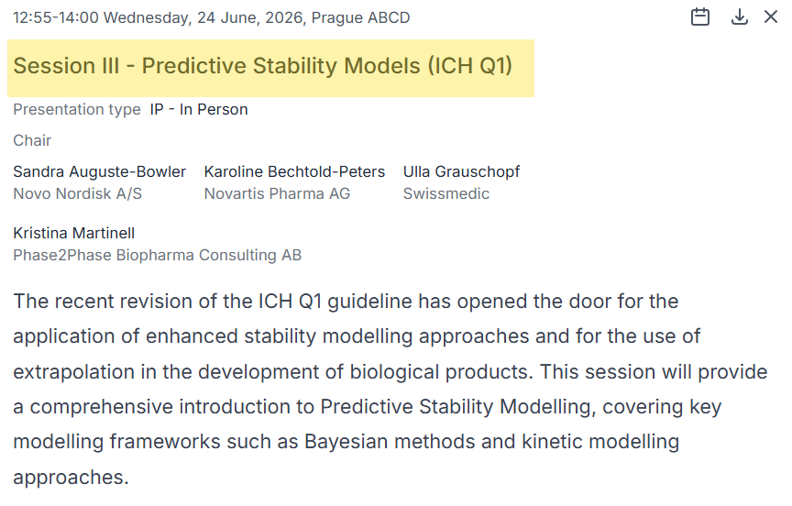
23-26 JUNE 2026 in Prague

